Slide 1
LSM-Tree overview
ADSL

Slide 2
CONTENTS
I. Background
II. Introduction
III. Architecture
IV. Operation

Slide 3
I. Background
01

Slide 4

I. Background
A. Data characteristics
B. Storage system
C. Key-value store

Slide 5
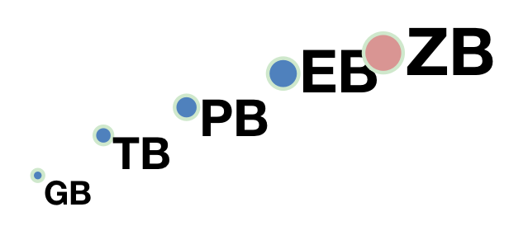




A. Data characteristics
In the Web2.0 era, the amount of data is growing exponentially
By 2025, the total amount of data in the world is expected to reach 175 zabytes (1ZB=1 billion terabytes)
Unstructured and semi-structured data have taken a dominant position (accounting for about 80% of the total data)
1PB = 2⁵⁰B
1EB = 2⁶⁰B
1ZB = 2⁷⁰B
web data
e-commerce data
social-app data
multimedia data

Slide 6
B. Storage system
Traditional storage systems face challenges
Traditional relational database
Suitable for structured data, multi-node massive data association
Use table structure to store and manage data, it is difficult to expand horizontally
File system
Directory tree management/massive small files
Scalability and metadata management become performance bottlenecks

Slide 7



C. Key-value store
What is a key-value store?
Data is stored in the form of <Key, Value> pairs, and Value is of any type
Simple interface
Put, Get, Delete, Scan
Wide range of applications
Numerous open source key-value systems: LevelDB, RocksDB, Cassandra, TiKV
Support NewSQL database, graph computing, distributed object storage, etc.
<Key, Value>
<Key, Value>
<Key, Value>
Memory
Disk

Slide 8
II. Introduction
02

Slide 9
I. Introduction
A. Concept
B. Application
C. Advantages and disadvantages

Slide 10
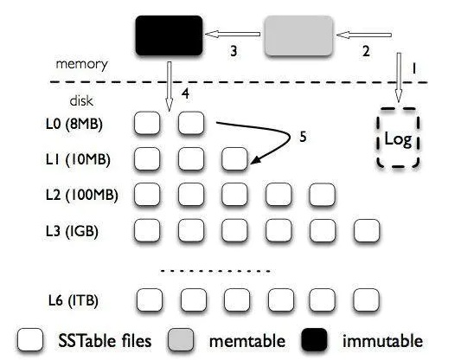
A. Concept
Mainstream persistent key-value (KV) storage system - LSM tree (Log-Structured-Merge-Tree)
Efficient write optimization
Efficient Scanning Performance
High space utilization
High scalability

Slide 11




B. Application
Widely used in modern KV storage systems
LevelDB
RocksDB
Cassandra
TiKV
Facebook
PingCAP
Google
Apache

Slide 12
C. Advantages and disadvantages
Advantages of LSM-tree:
Better write performance: LSM-trees optimize for write performance
Space efficiency: multiple levels and compaction reduces the amount of space required to store the same amount of data
Crash recovery: provide a built-in mechanism for crash recovery
Disadvantages of LSM-tree:
Read performance: slower than B-trees
Write amplification: compaction can result in a higher number of writes
Memory usage: buffer incoming writes in memory can lead to high memory usage

Slide 13
III. Architecture
03

Slide 14
III. Architecture
A. System structure
B. Core structure
C. Memory Table
D. SSTable
E. Bloom Filter
F. Table Cache && Block Cache
G. Log

Slide 15
A. System structure
System structure
Divide into memory and disk
Memory
Store recently updated key-value data as a buffer
Disk
Store logs and persist key-value data
Hierarchical structure
the inter-layer size is scaled up proportionally (Usually 10 times)
Each layer has multiple data files (SSTables)
The data in the layer is stored sequentially (except L0 layer)
Data disorder between different layers

Slide 16
B. Core structure
Memory Table:
An in-memory data structure that holds the most recently updated data.
SSTable Files:
Hierarchical file structure on disk to store persistent data
Each layer has multiple SSTables, and the layers are ordered
Log:
Logs stored to disk

Slide 17
C. Memory Table
_{KV-Pair}
Memory Table is divided into two categories:
MemTable
Write buffer for key-value data
can read and write
Immutable MemTable
MemTable that is about to be persisted to disk
read only not writable
Both data structures are exactly the same
The mainstream adopts the SkipList structure
Follow up in detail
_{MemTable}
Immutable
MemTable
Memory
Disk
_{SSTable}

Slide 18
C. Memory Table
Memory Table state transition
The key-value data written by the user is directly inserted into the MemTable
Switch to Immutable MemTable after the MemTable size exceeds the threshold
The background thread saves Immutable MemTable to disk through flush
_{KV-Pair}
_{MemTable}
Immutable
MemTable
Memory
Disk
flush
_{SSTable}

Slide 19
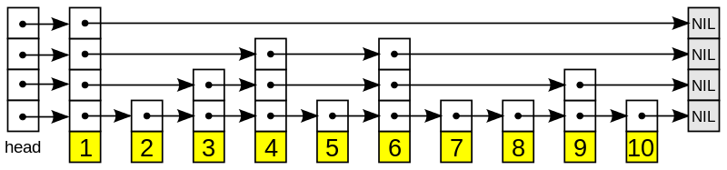
C. Memory Table
The mainstream of Memory Table adopts the skip list (SkipList) structure
Jump table (SkipList)
An in-memory data structure that can be used instead of a search tree
Add some indexes on top of an ordered linked list
Simulate binary search through a random rule (guaranteed a certain probability)

Slide 20
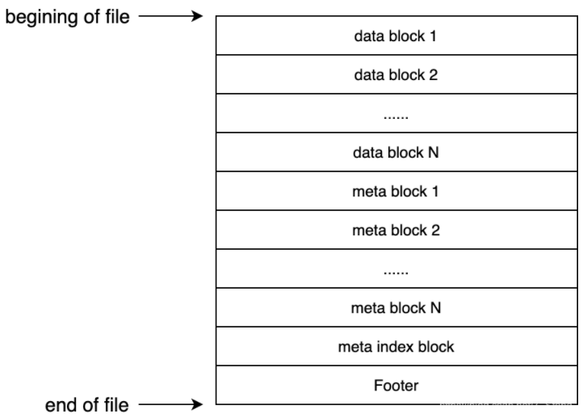
D. SSTable
SSTable internal structure
Footer && meta index block
Data block data block (multiple)
metadata block meta block (multiple)

Slide 21
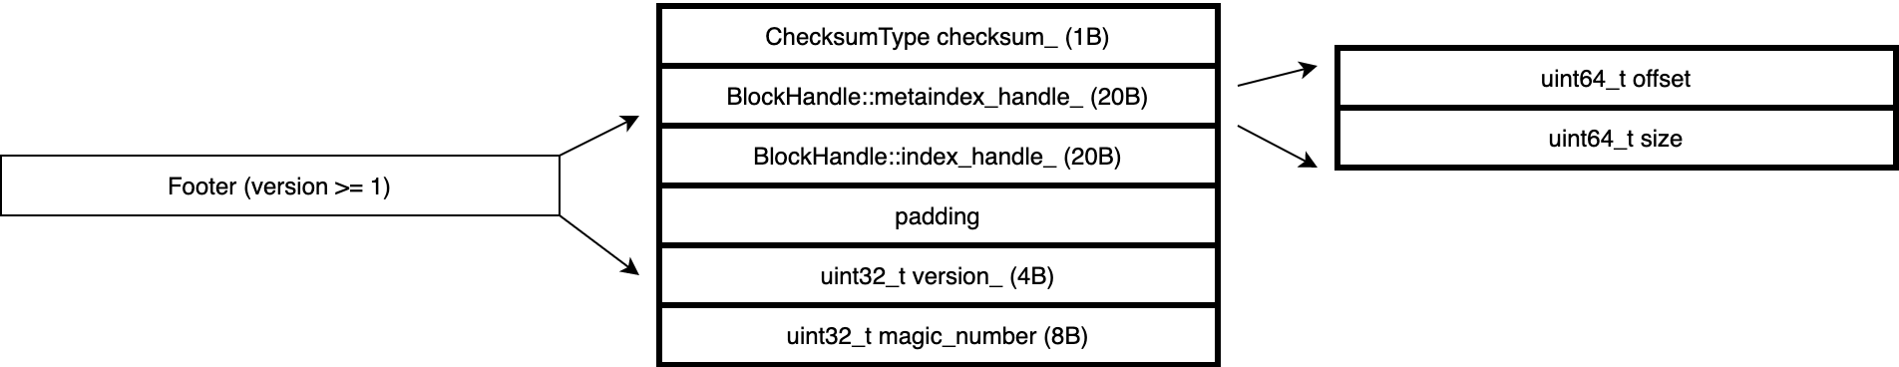
D. SSTable
Footer
Multiple handles and necessary file information are saved
metaindex_handle
Offset
size
Index_handle
Offset
size

Slide 22
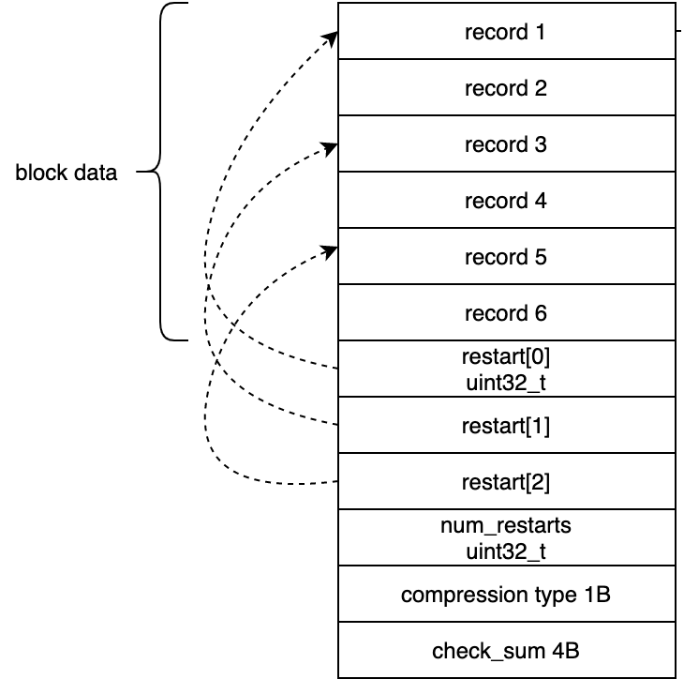
D. SSTable
Data block data block (4KB)
Store multiple ordered key-value pairs record record
Order within a block and order between blocks
Use binary search within the data block

Slide 23
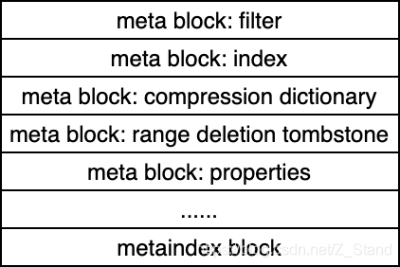
D. SSTable
Metadata block meta block (4KB)
Save various metadata of SSTable
Index Block Index Block
used to index data blocks
Bloom Filter
used to filter unnecessary queries
a certain rate of misjudgment

Slide 24
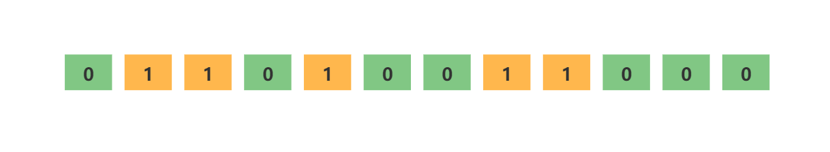
E. Bloom Filter
principle
a large bit array (binary array)
set of hash functions
the key can be evenly mapped into the bit array
can guarantee the correctness of the query
the non-existent key may not be able to be filtered, and it is judged as non-existent after further query
the filtered key must not exist

Slide 25
F. Table Cache && Block Cache
In order to reduce IO and speed up lookups, key-value storage systems usually use Cache in memory to speed up access to SSTables
Data access is local
According to different functions, there are two types of caches in LevelDB/RocksDB:
Table Cache
Block Cache
Both are implemented based on LRU Cache

Slide 26
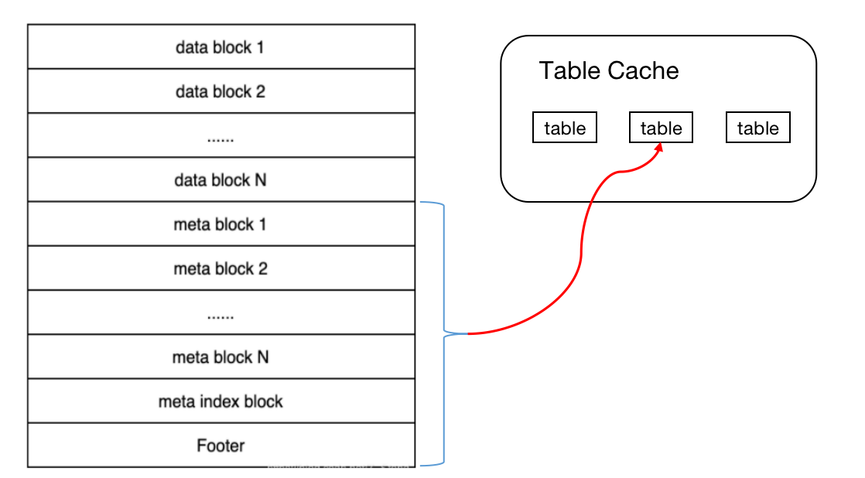
F. Table Cache && Block Cache
Table Cache
The metadata information of SSTable is encapsulated in table, including:
file descriptor
Index block
Bloom Filter

Slide 27
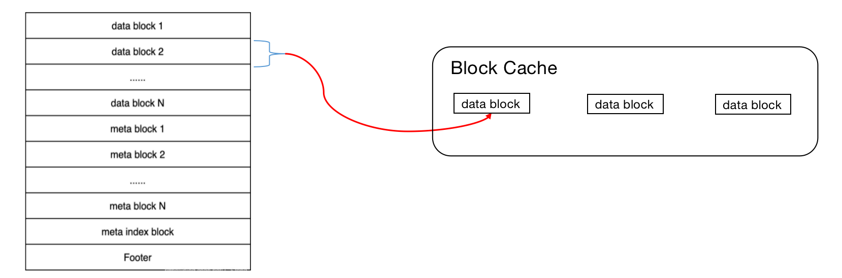
F. Table Cache && Block Cache
Block Cache
Cache recently accessed data blocks (data block)
Can speed up access to hot data

Slide 28
G. Log
LSM tree uses Log files to ensure that data will not be lost
Before writing the record to the Memtable in memory, it will first write to the Log file on the disk
When the system fails, the Memory Table in the memory is not persisted to the SSTable
The LSM tree restores the content of the Memtable data structure of the memory based on the log file
ensure that data is not lost
_{MemTable}
2
_{KV-Pair}
Memory
Disk
1
Log

Slide 29
IV. Operation
04

Slide 30
IV. Operation
A. LSM-Compaction
B. LSM-Get(key)
C. LSM-Put(key, value)

Slide 31


A. LSM-Compaction
Compaction: Merge some files into the next layer
when the size of the n^{th} layer exceeds the threshold, Compaction will be triggered
Select part of the SSTables of the n^{th} layer, and select the SSTables that overlap with the range of the n+1th layer
Perform multi-way merge and sort on the two layers of files to generate a new SSTable
Write the newly generated SSTable back to n+1th layer
$$L_{ n}$$
Compaction
$$L_{ n}$$
$$L_{ n+1}$$
$$L_{ n+1}$$
SSTable
selected SSTable
newly generated SSTable

Slide 32
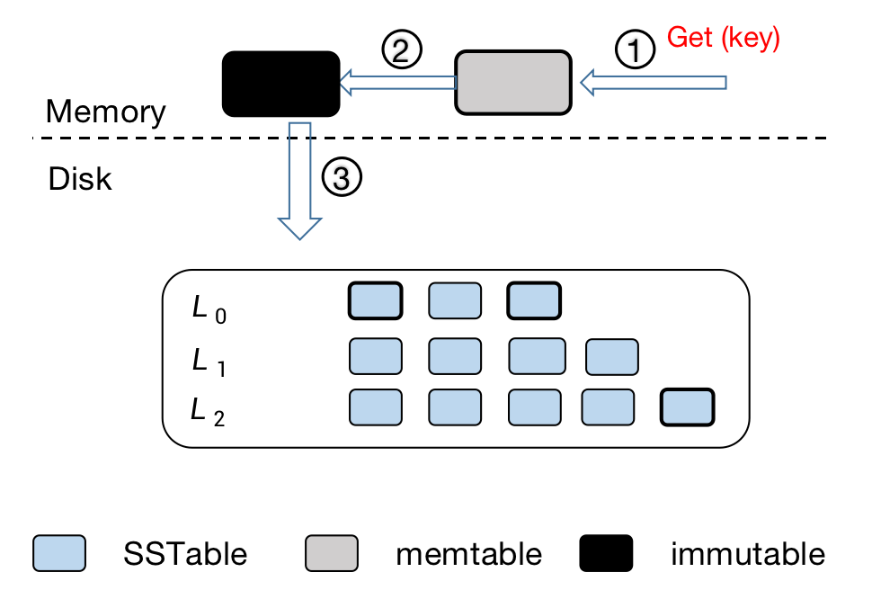
B. LSM-Get(key)
Query process of LSM tree (Get)
Find memtable in memory
Find the immutable memTable that has not been placed in the memory
Query SSTable files sequentially by layer
Details below

Slide 33
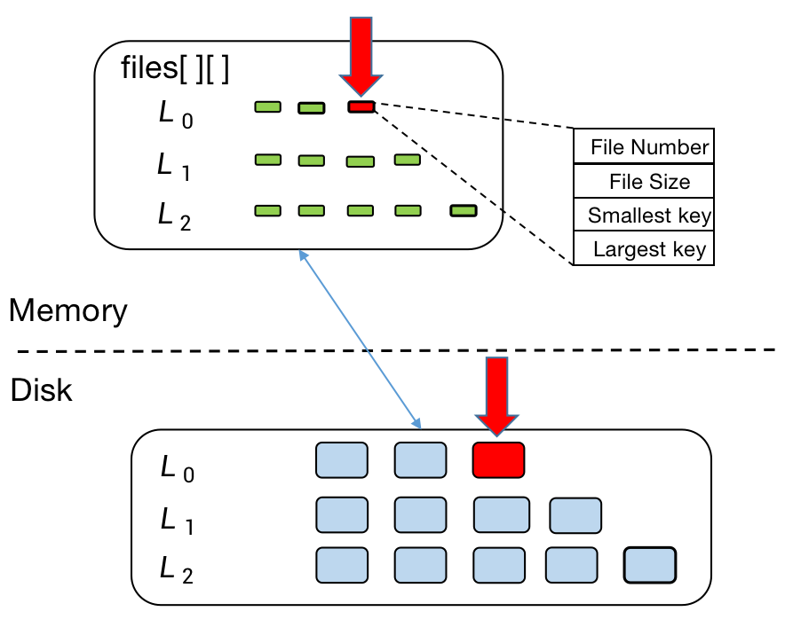
B. LSM-Get(key)
Query SSTable files sequentially by layer
first access the lowest level of files in memory
files is a two-dimensional variable-length array
is a map of all SSTable files on disk
save the most basic information of the SSTable file
File number
File size
Min and Max
Determine an SSTable according to the range of the key

Slide 34
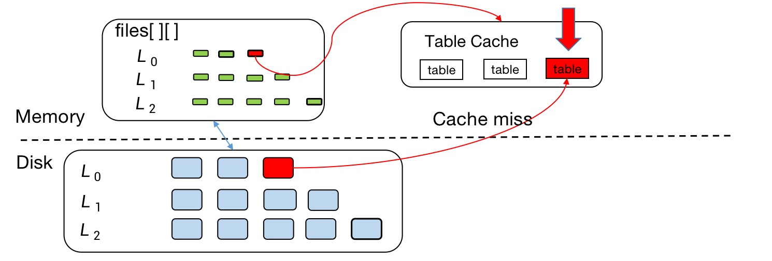
B. LSM-Get(key)
Query SSTable files sequentially by layer
Find the metadata of the SSTable in the Table Cache
If the cache miss, access the disk to open the corresponding file, and read the metadata into the Table Cache

Slide 35
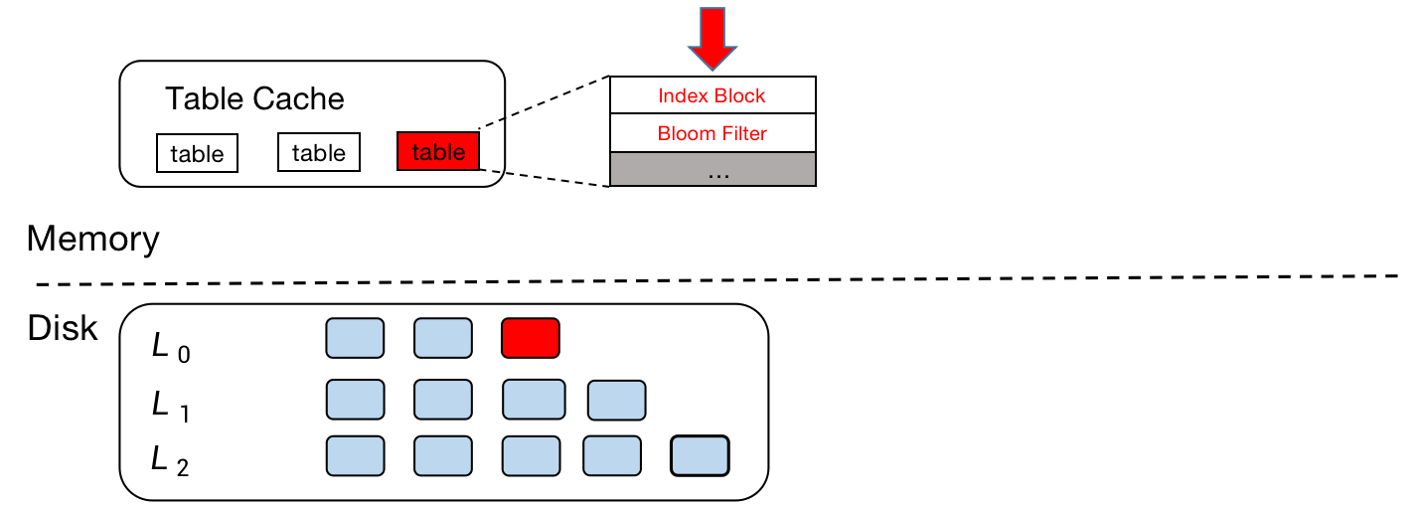
B. LSM-Get(key)
Query SSTable files sequentially by layer
Find a data block with a suitable range through the index block (Index Block) of metadata, and use the Bloom filter to determine whether to filter the query
If the Bloom filter returns true, filter the query and return to query the next SSTable

Slide 36
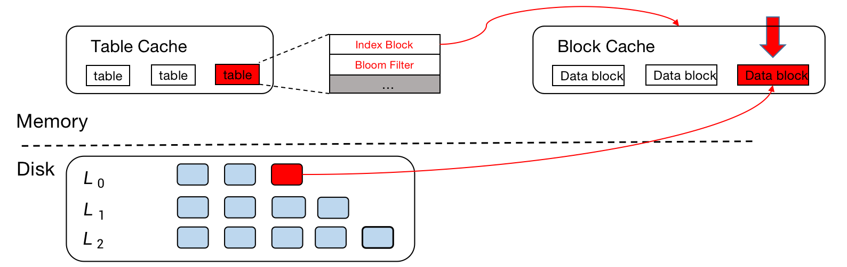
B. LSM-Get(key)
Query SSTable files sequentially by layer
If the Bloom filter returns false, access the Block Cache and query the indexed data block (data block)
If the cache miss, access the SSTable in the disk and read the corresponding data block into the Block Cache

Slide 37
B. LSM-Get(key)
Query SSTable files sequentially by layer
If the key is found in the data block, the corresponding value is returned; otherwise, return to query the next SSTable

Slide 38
C. LSM-Put(key, value)
Writing process of LSM tree (Put)
write operations are added to the WAL log
write the data to the memtable
when the memtable is full, switch to an immutable memtable, and open a new memtable to receive new write requests
flush the immutable memtable to the disk, and flush it into an SSTable file of the L0 layer

Slide 39
THE END
THANKS

